Slide 1
Information and Communication Technologies
TIC
AUTHORS :
BELMADI AHMED
HOUCHINE ABD EL SAMED
YASSER LETTOUNE
HAITHEM BOUGHEFIR
FERHAT OMAR

Slide 2
Table of Contents
Introduction to Information and Communication Technologies (ICT)
  Definition of ICT
  Key Components of ICT
  Importance of ICT
Google Services
  Search and Discovery
    Google Search
    Google News
    Google Trends
  Communication and Collaboration
    Gmail
    Google Meet
    Google Chat
    Google Drive
  Content Creation and Productivity
    Google Docs, Sheets, and Slides
    Google Forms
    Google Keep

Slide 3
  Entertainment and Media
    YouTube
    Google Play
    YouTube Music
  Navigation and Travel
    Google Maps
    Google Earth
    Google Flights
  Artificial Intelligence and Machine Learning
    Google Assistant
    Google Translate
    Google Lens
  Business Solutions
    Google Ads
    Google Analytics
    Google Workspace

Slide 4
Microsoft Tools
  Microsoft Word
  Microsoft Excel
  Microsoft PowerPoint
  Microsoft Outlook
  Microsoft Teams
  OneDrive
  Windows OS
  Microsoft Edge
  Power BI
  Xbox
Git and GitHub
  Introduction to Git
  Key Features of GitHub
  Role of Git and GitHub in Modern Software Development
  GitHub’s Impact on Collaboration and Innovation

Slide 5
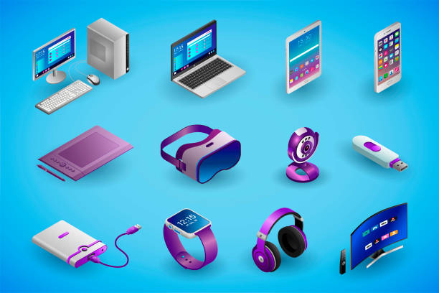
Introduction :
Information and Communication Technologies (TIC) encompass the tools, systems, and technologies used to manage, transmit, and process information.
Key Components of TIC:
Hardware: Physical devices like computers, servers, smartphones, and networking equipment.

Slide 6


Software: Applications, operating systems, and platforms used to manage and utilize hardware.
Networks: Infrastructure enabling connectivity, including the internet, intranets, and telecommunications networks

Slide 7

Data:
The raw information collected, processed, and shared through tic systems
Importance of TIC:
Connectivity: Facilitâtes communication regardes of distance.
Efficience: Enhances operational workflows in industries.
Innovation: Drives the development of new tools and services.
Inclusion: Promotes access to education, health services, and economic opportunities.TIC has evolved into an essential aspect of daily life, fostering globalization and contributing to the sustainable development of societies.

Slide 8
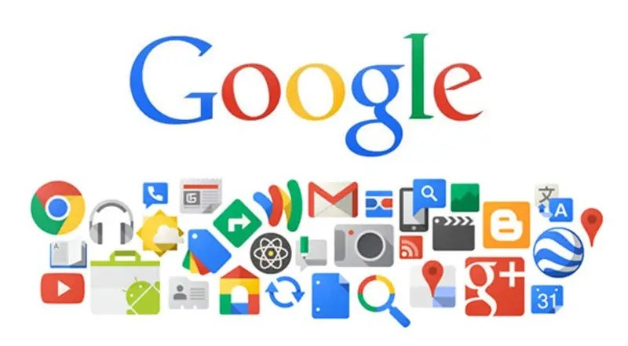
Google Services:
Google, founded in 1998 by Larry Page and Sergey Brin, has grown from a simple search engine into a global technology leader offering a diverse range of services and products. These services cater to individuals, businesses, and developers, empowering them to connect, collaborate, and innovate. Here's an overview of Google's key services categorized by their primary functions
1. Search and Discovery
Google Search:
Core service that helps users find information from the web.
Features include autocomplete, personalized results, and instant answers.

Slide 9
Google News:
A platform for aggregated news from various publishers.
Provides curated updates on global and local events.
Google Trends:
Offers insights into popular searches and trends over time.
2. Communication and Collaboration
Gmail:
One of the most widely used email services globally.
Features include spam filtering, smart replies, and extensive storage.
Google Meet:
A video conferencing platform for virtual meetings and webinars.
Supports features like screen sharing and live captions.

Slide 10
Google Chat:
A messaging app integrated with Gmail for team communication.
Google Drive:
A cloud storage solution for saving and sharing files securely.
Includes seamless integration with Google Docs, Sheets, and Slides.
3. Content Creation and Productivity
Google Docs, Sheets, and Slides:
Online tools for word processing, spreadsheets, and presentations.
Allow real-time collaboration and automatic saving in the cloud.
Google Forms:
Tool for creating surveys, quizzes, and feedback forms.
Google Keep:
A note-taking application for organizing ideas and tasks.

Slide 11
4. Entertainment and Media
YouTube:
The world’s largest video-sharing platform.
Offers videos, live streaming, and original content from creators.
Google Play:
A digital distribution platform for apps, games, music, movies, and books.
YouTube Music:
A music streaming service with personalized playlists and offline listening.
5. Navigation and Travel
Google Maps:
A mapping and navigation service with real-time traffic updates.
Includes features like street view, satellite imagery, and local business listings.
Google Earth:
A virtual globe for exploring the world’s geography in detail.
Google Flights

Slide 12
Google Flights:
A service to search, compare, and book airline tickets
6. Artificial Intelligence and Machine Learning
Google Assistant:
A virtual assistant for managing tasks, setting reminders, and answering queries.
Google Translate:
A language translation tool supporting text, voice, and image translations.
Google Lens:
A visual search tool that identifies objects, translates text, and finds similar items.
7. Business Solutions
Google Ads:
An advertising platform for creating campaigns across search, display, and video.
Google Analytics:
A tool for analyzing website traffic and user behavior.

Slide 13
Google Workspace (formerly G Suite):
A suite of productivity tools including Gmail, Calendar, Drive, and Docs designed for businesses
Microsoft Tools:
Microsoft Corporation, founded in 1975 by Bill Gates and Paul Allen, is one of the most influential technology companies in the world. Its journey from a small software startup to a global leader in computing, software, and technology innovation is a story of vision, perseverance, and groundbreaking innovation.
Here are the most widely used Microsoft tools, known for their impact on productivity, collaboration, and personal use:
1. Microsoft Word
Popular word processor for creating documents, resumes, and reports.
Essential for personal, educational, and professional use
2. Microsoft Excel
A go-to tool for data analysis, budgeting, and creating spreadsheets.
Frequently used in businesses for financial modeling and reporting.

Slide 14
3. Microsoft PowerPoint
Widely used for creating engaging presentations for meetings, lectures, and training.
4. Microsoft Outlook
A versatile tool for managing email, calendar, and contacts.
Common in workplace communication and scheduling.
5. Microsoft Teams
A leading platform for chat, video conferencing, and collaboration.
Integrated into many organizations for remote work and team projects.
6. OneDrive
Cloud storage service for saving, syncing, and sharing files.
Ensures accessibility across devices.

Slide 15
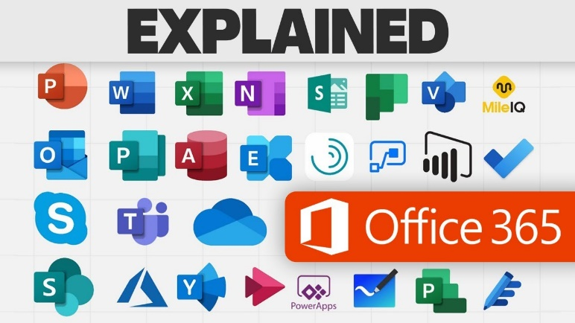
7. Windows OS
The operating system powering billions of personal computers worldwide.
Central to daily computing activities.
8. Microsoft Edge
A web browser known for speed, security, and integration with other Microsoft services.
9. Power BI
A tool for creating interactive dashboards and visualizations.
Essential in business intelligence and data analytics.
10. Xbox
A leading gaming platform with consoles and online gaming services.

Slide 16

Git and github :
GitHub operates on Git, an open-source version control system created by Linus Torvalds in 2005 for managing the Linux kernel's development. Git allows developers to track file changes, maintain a history, and experiment with new features via branching. This branching model ensures testing of changes before merging into the main codebase.
GitHub enhances Git with features such as Pull Requests, Issue Tracking, and Workflow Automation through GitHub Actions. Developers can push updates to remote repositories, collaborate with team members, and streamline project management. GitHub also supports GitHub Pages for easy website deployment and integrates with tools like Jenkins, Docker, and Slack.
. GitHub centralizes collaboration, fosters global open-source contributions, and accelerates

Slide 17
Thank you for your attention

